Slide 1
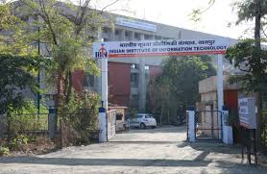
PROJECT TITLE
COVID-19 DATA ANALYSIS & SENTIMENT ANALYSIS
AT
INDIAN INSTITUTE OF INFORMATION TECHNOLOGY NAGPUR
UNDER THE GUIDANCE OF
Prof. & Dr. Mayuri Digalwar
IIIT Nagpur
GROUPS OF WORKING PEOPLE
1. ARVIND KUMAR SAHU (BT17CSE087)
2. SHUBHAM MUNALE (BT17CSE088)
3. MANTHAN CHAURASIA (BT17CSE105)

Slide 2
Works covered in 1st Presentation
Problem Statement
Motivation behind Problem
Objectives
Abstract
Literature Survey
Methodology
Conclusion

Slide 3
Work Done till Now
Data Collection
Exploring Global Corona Virus Cases
Exploring Coronavirus Cases from Different Countries and comparision
Pie Chart Visualizations for COVID-19
World Wide Confirmed Cases Prediction

Slide 4
Data Collection :
For World Wide Data Analysis
Data collected from John Hopkins University and kaggle
For India Specific Data
data collected from ICMR, WHO and kaggle
For Sentiment analysis
Data collected from twitter dataset in IBM comptetion

Slide 5
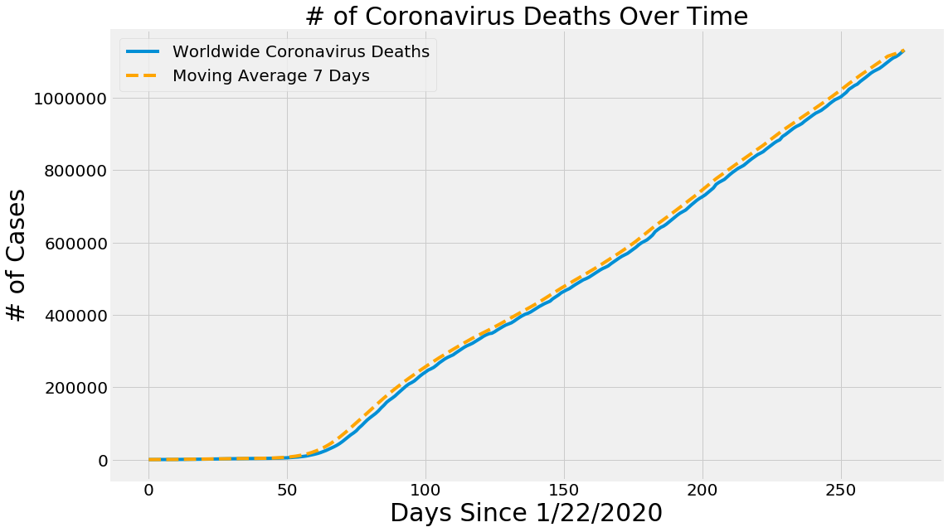
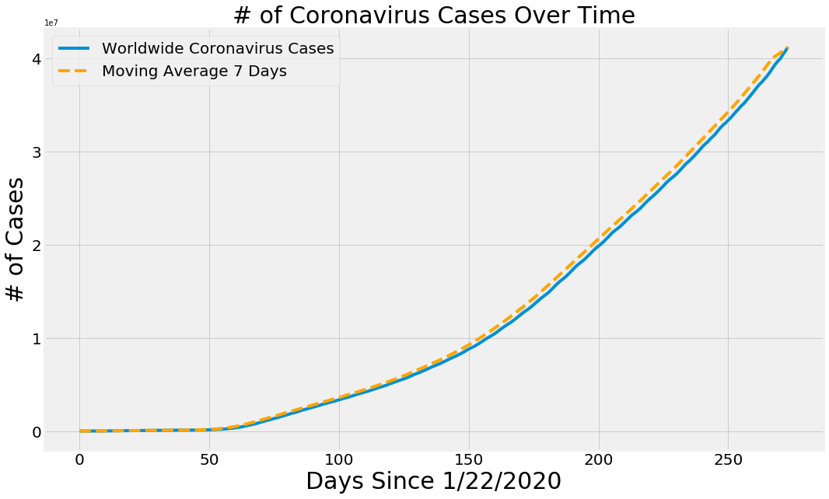
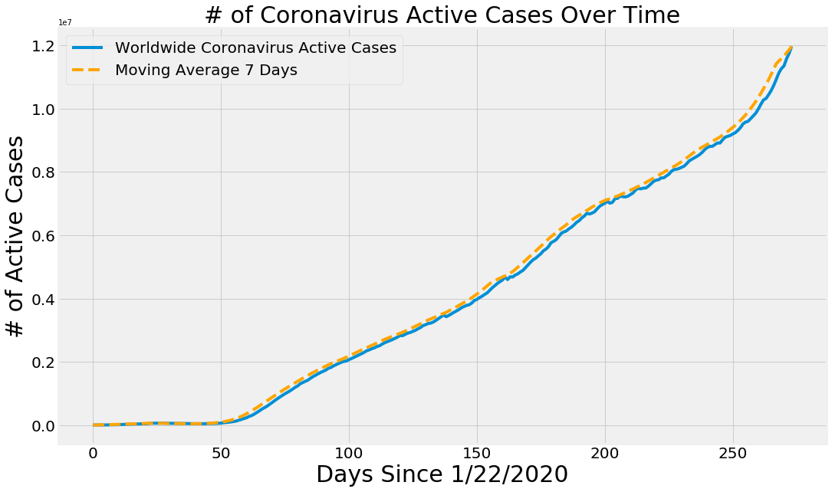
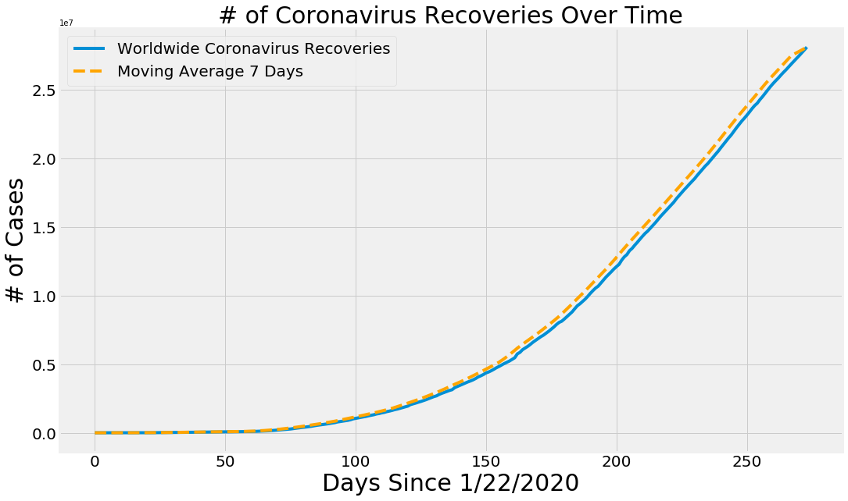
Exploring Global Corona Virus Cases :

Slide 6
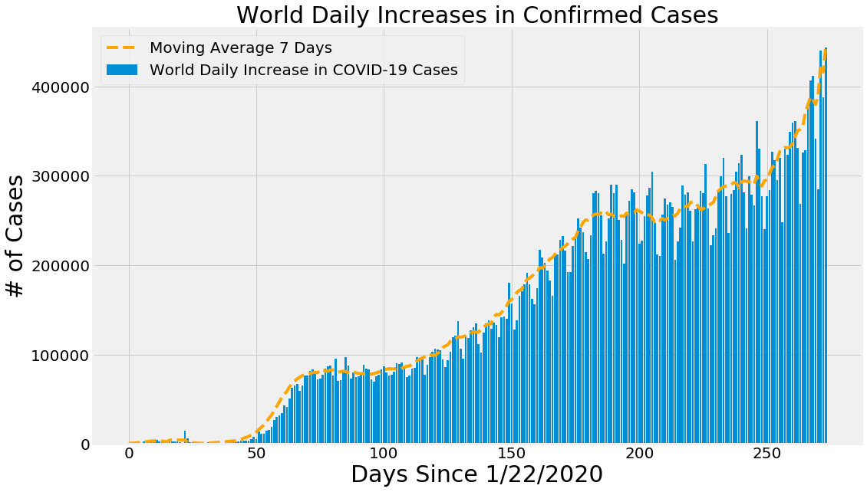

Slide 7
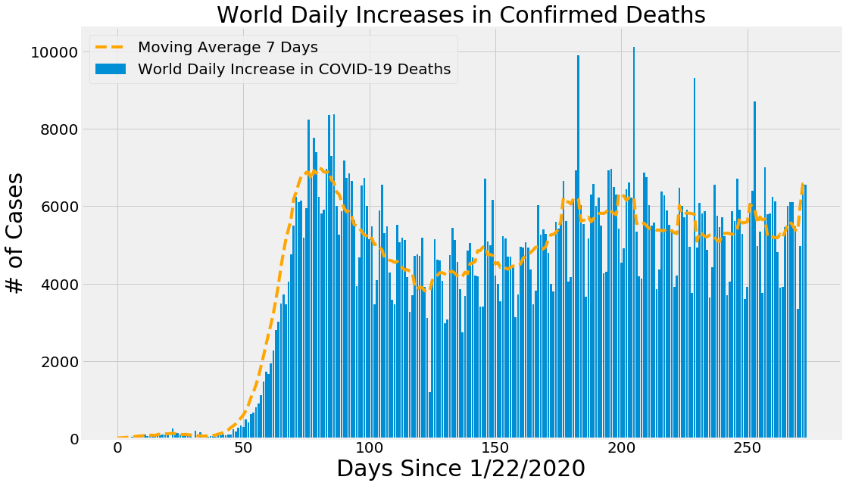
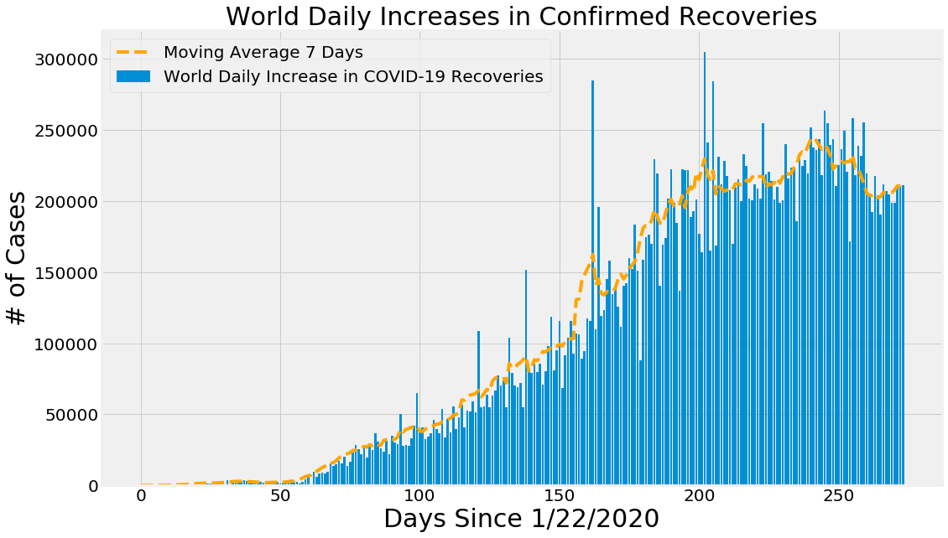
So on……….

Slide 8
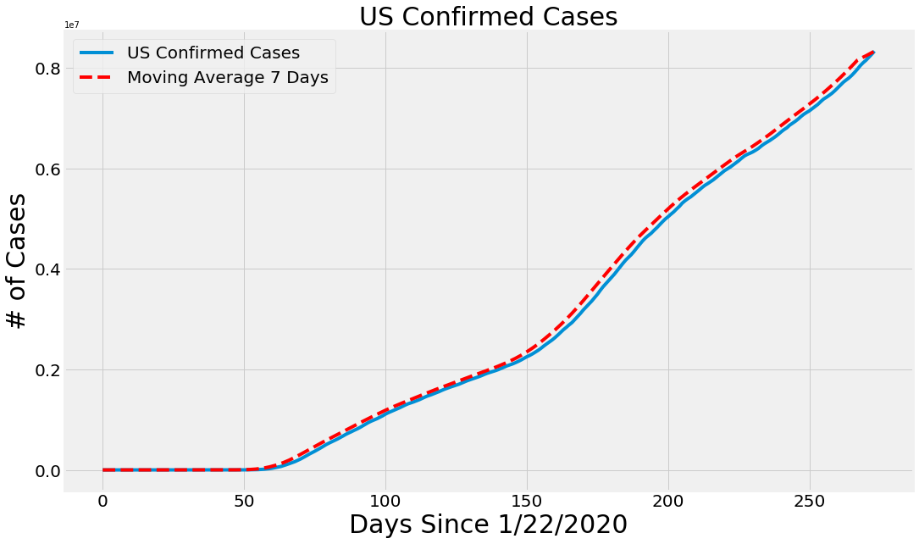
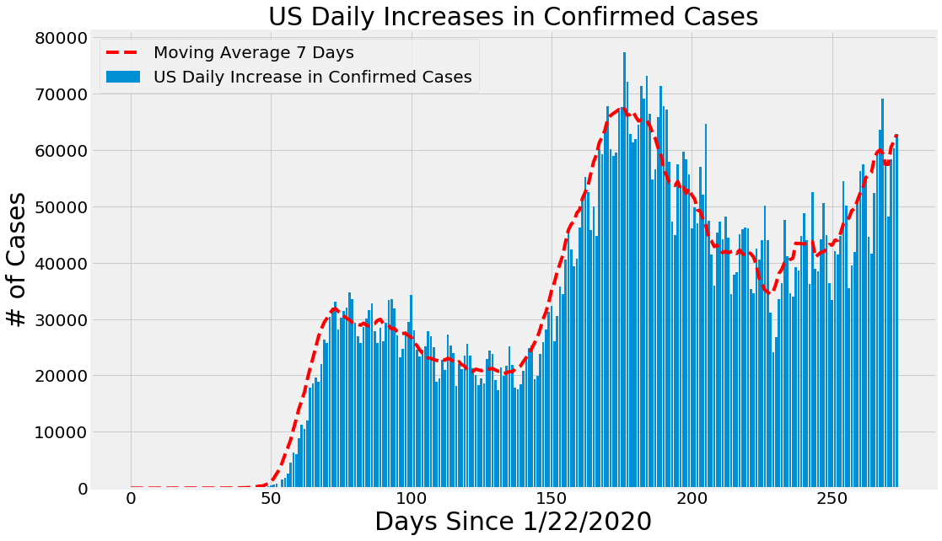
Exploring Coronavirus Cases from Different Countries :
In US

Slide 9
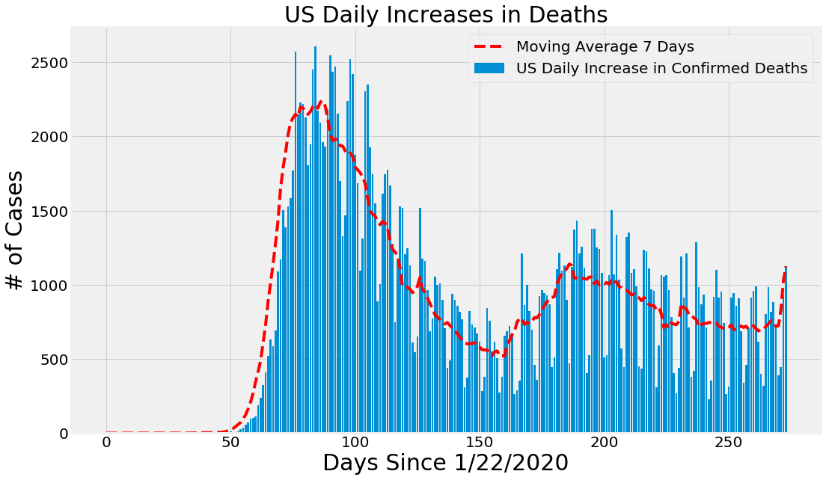
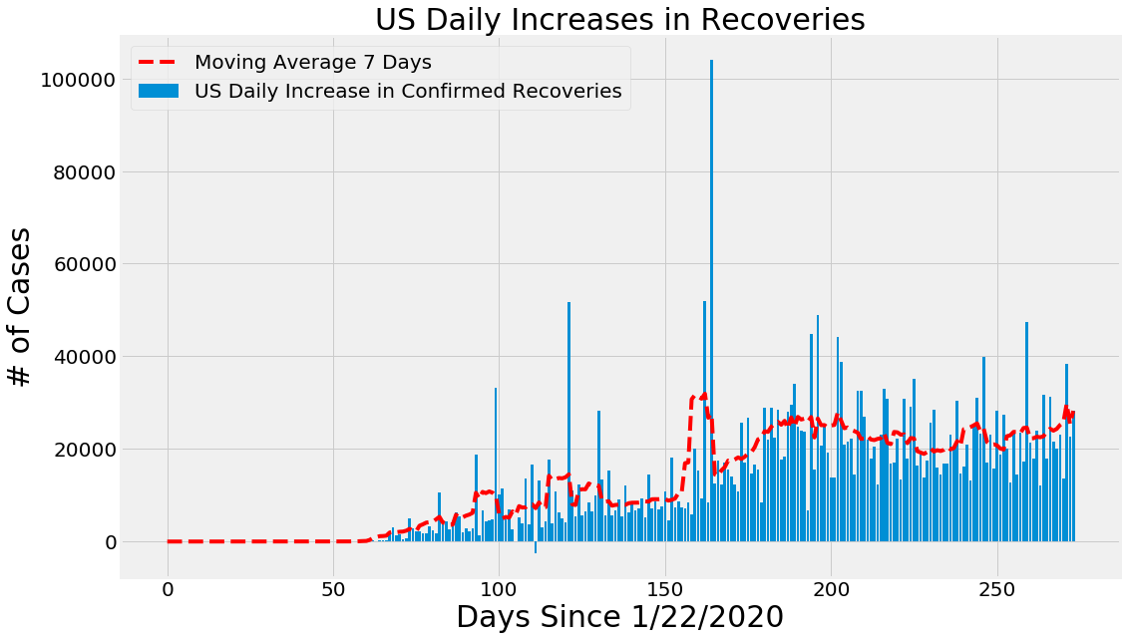

Slide 10
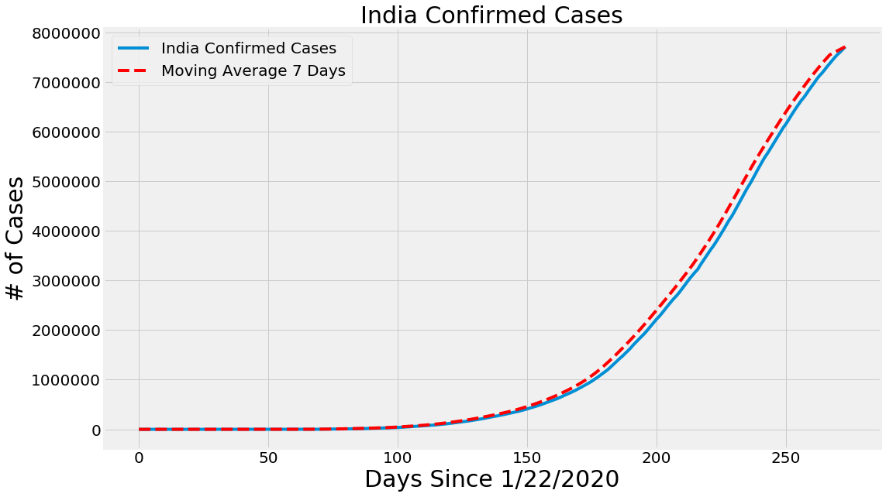
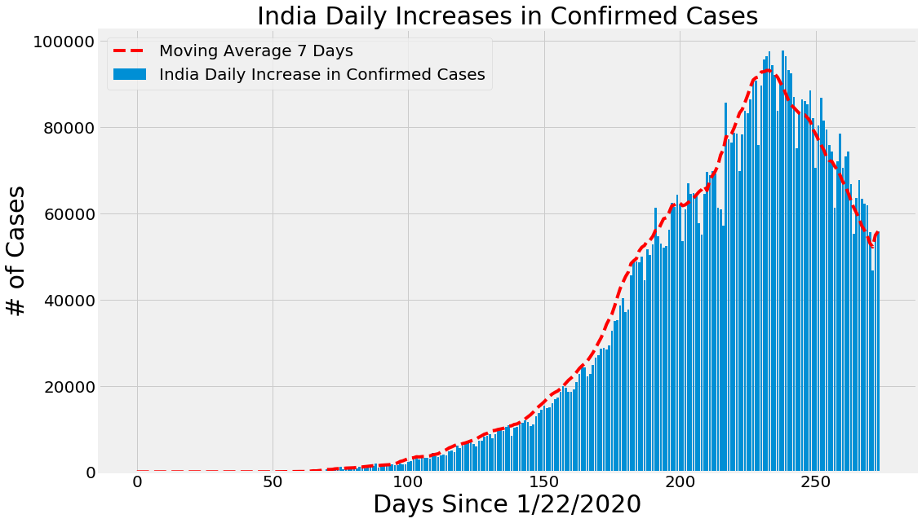
In India

Slide 11
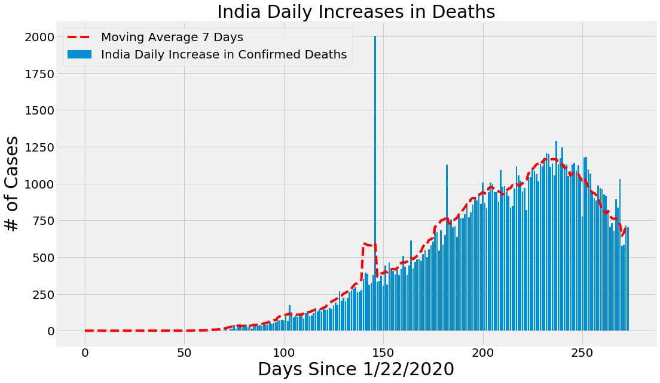
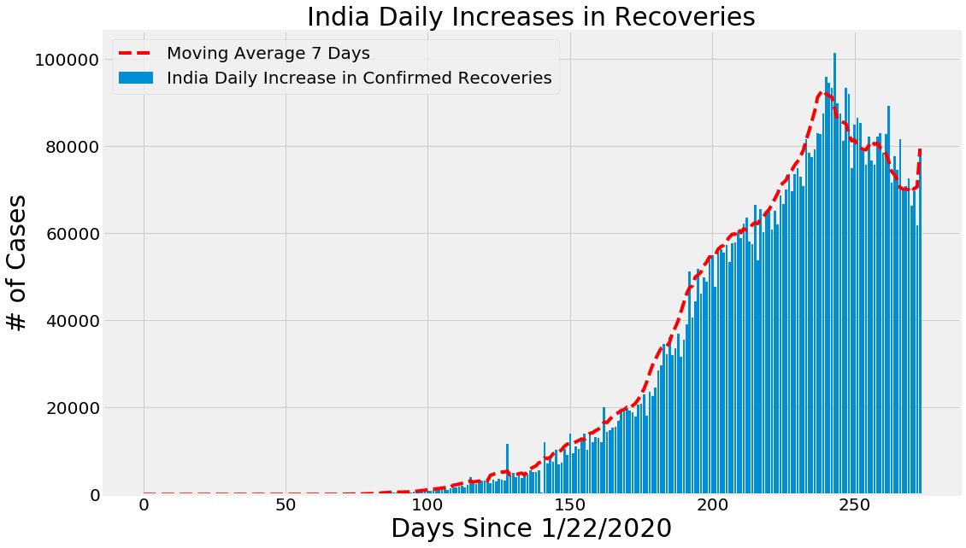
So On…… for all other country

Slide 12
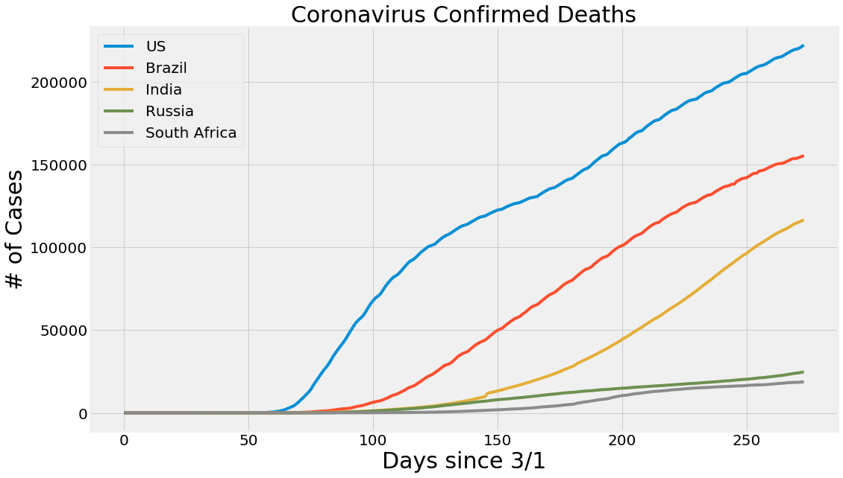
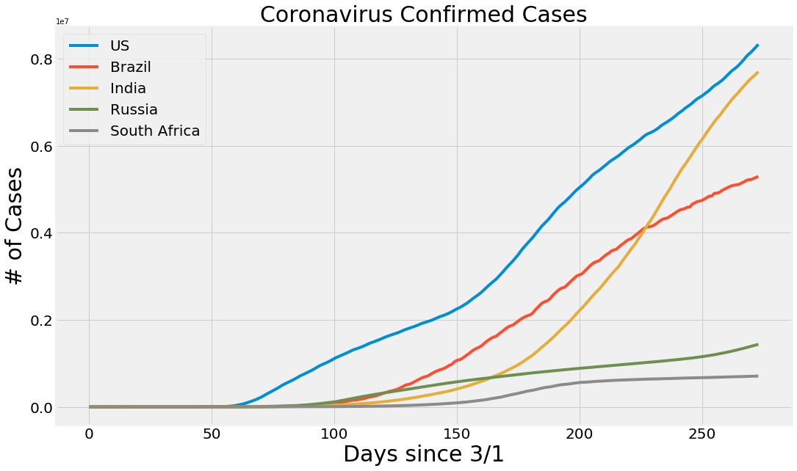
Comparision among top 5 countries :

Slide 13
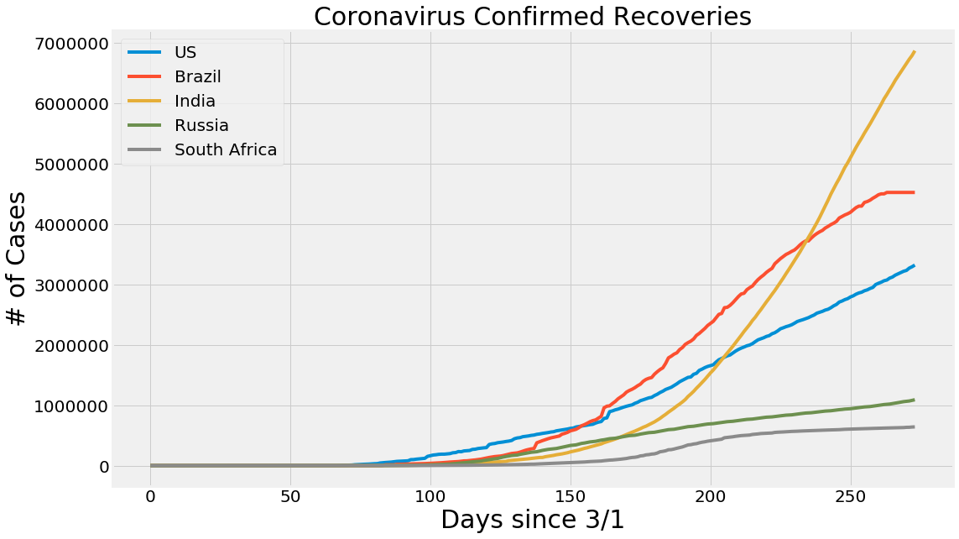

Slide 14
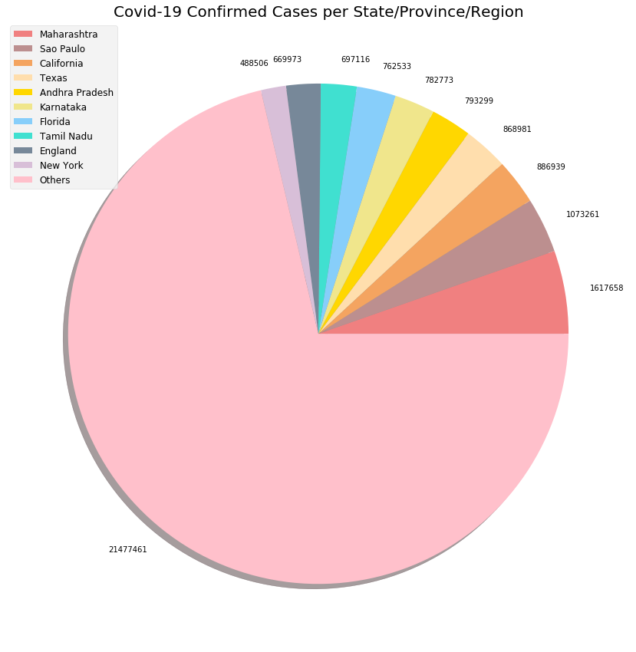
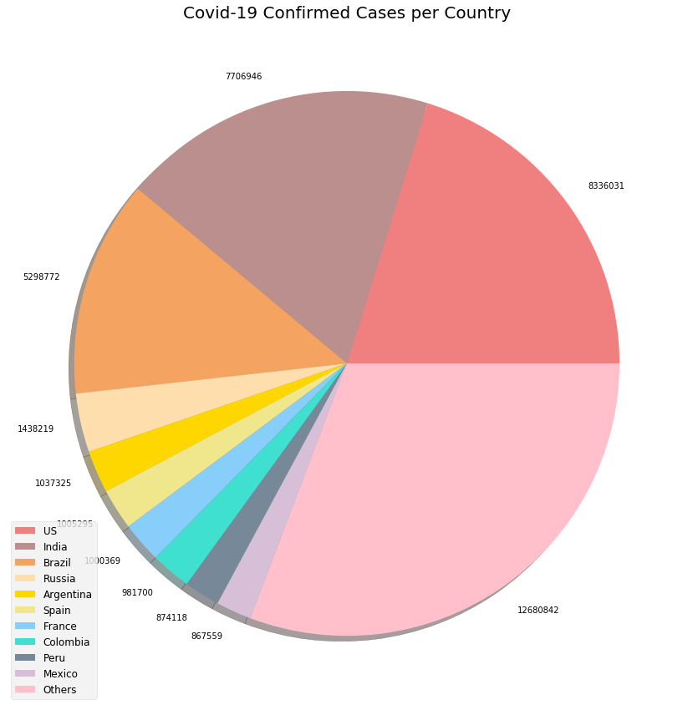
Pie Chart Visualizations for COVID-19 :

Slide 15
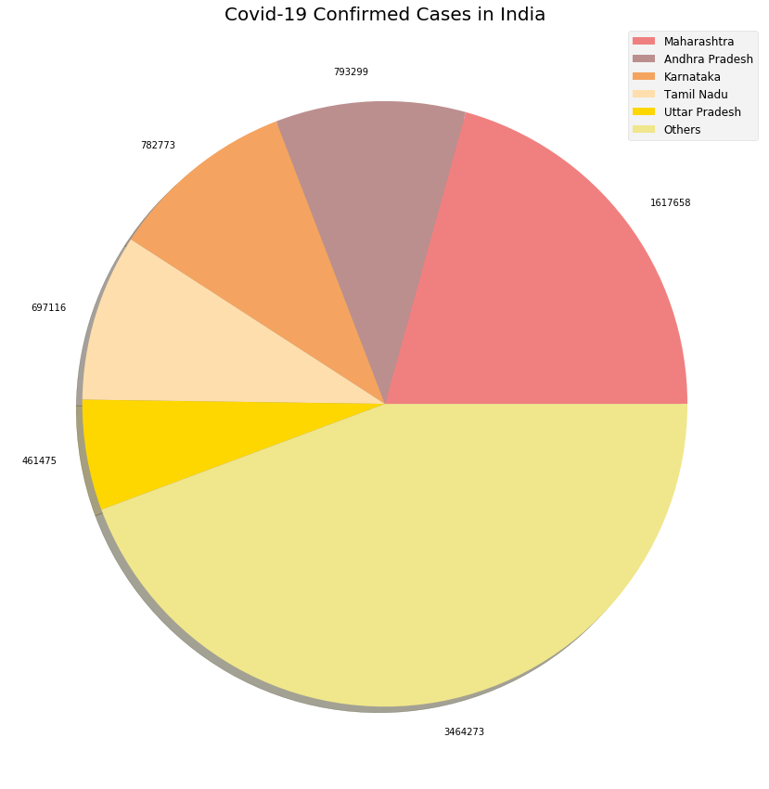
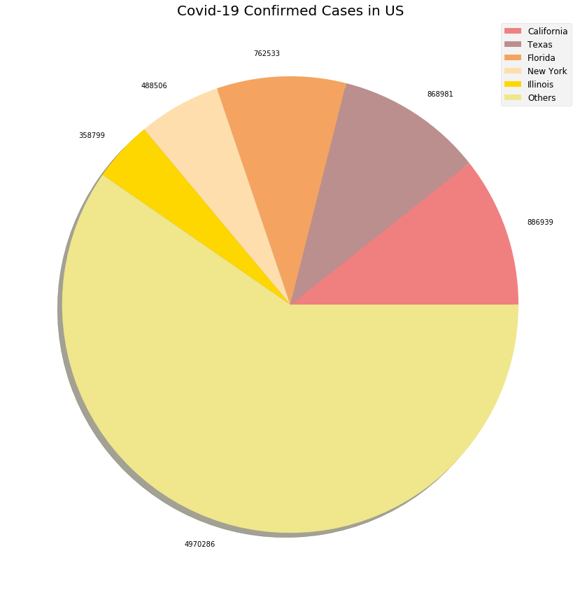
And so on….. For other countries

Slide 16
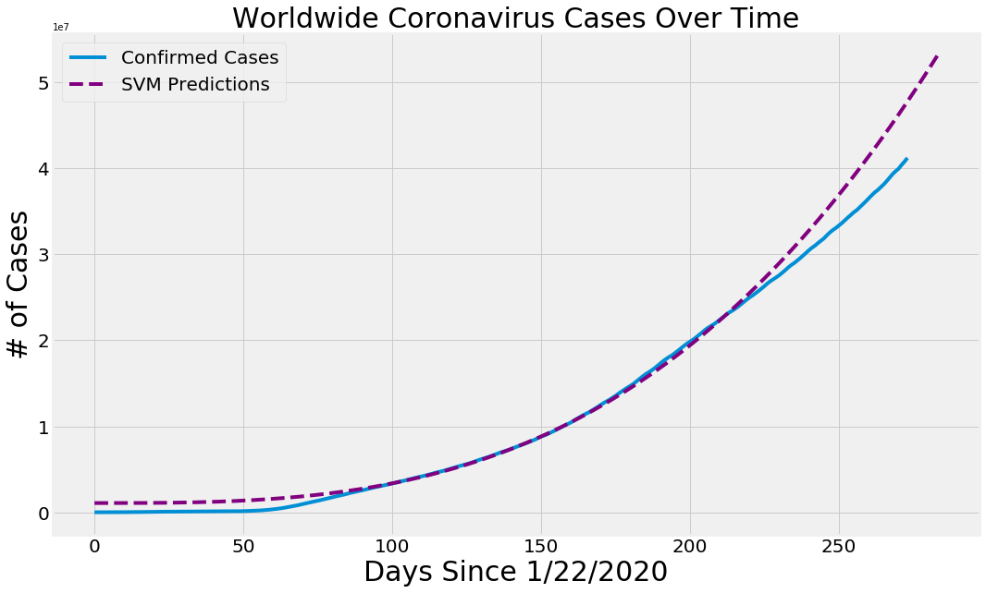
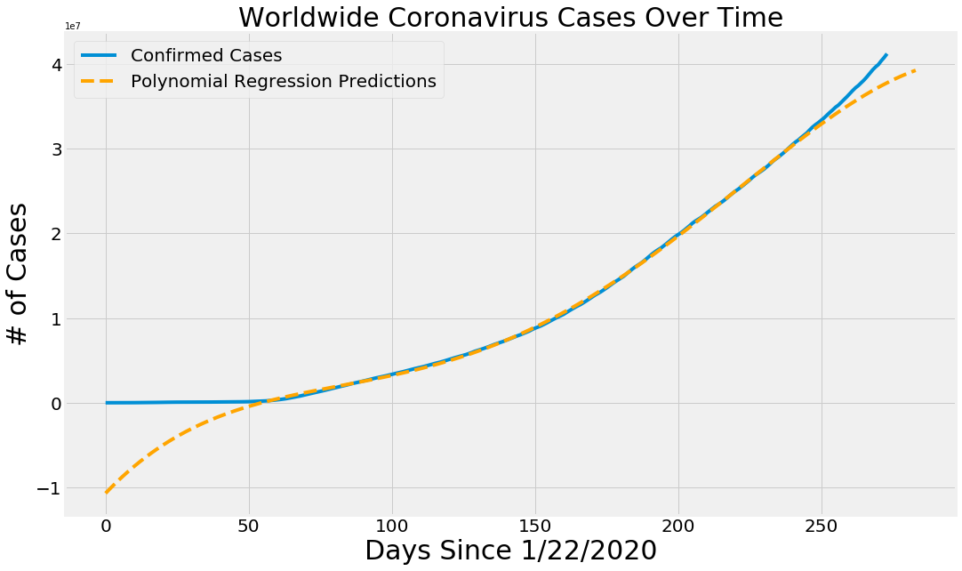
World wide Confirmed Cases Prediction :
SVM Prediction :
Polynomial Regression Predictions

Slide 17
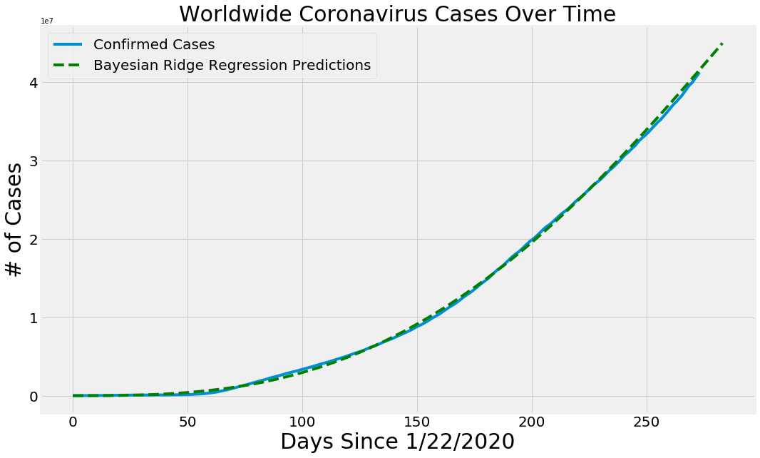
Bayesian Ridge Regression Predictions :

Slide 18
Work to be done next
Detailed analysis of COVID-19 in India with each possible aspect
COVID-19 sentiment analysis
Integration of all modules

Slide 19
References
**Juan M. Banda, Ramya Tekumalla, Guanyu Wang,
Jingyuan Yu, Tuo Liu, Yuning Ding, and Gerardo
Chowell. 2020. A Twitter Dataset of 150+ million
tweets related to COVID-19 for open research.
Type: dataset.
**Emily Chen, Kristina Lerman, and Emilio Ferrara.
2020. #COVID-19: The First Public Coronavirus
Twitter Dataset. Original-date: 2020-03-
15T17:32:03Z.
**Andrew Gelman. 2017. The piranha problem in social
psychology / behavioral economics: The ”take a pill”
model of science eats itself - Statistical Modeling,
Causal Inference, and Social Science.
**The Guardian. 2020. Coronavirus latest: 5 April at a
glance. The Guardian.
**John Hopkins University
**Kaggle.com

Slide 20
The End

